Slide 1

OMNOMNOM: Machine-Assisted Cooking
Miriam Cha, Michelle Deng, and Melih Elibol

Slide 2
Outline
Motivations
Objectives
Preliminary Results
Paper Prototype
User Study
System
Next Steps

Slide 3
Motivations
Cooking is one of the essential human skills
Compared to prepackaged and most restaurant meals, homemade meals are healthier, economical, and give more control
Unfortunately, frequency of home cooking for younger generation has significantly decreased
Perceived to be too stressful and time-consuming, therefore not worthy of the trouble
Can we bring back old fashioned homemade meals?

Slide 4
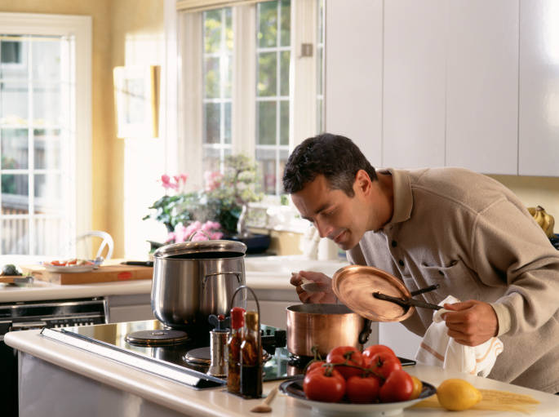
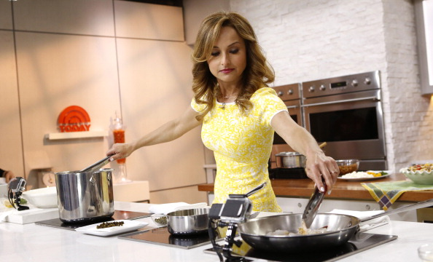
Objectives
Investigate the role of homemade meal
Present our experiences seeking to develop a machine assisted cooking interface that allows novices to develop an efficient schema for cooking and experienced cooks to quickly learn new recipes
Notes:
- Investigate the role of homemade cooking through reference searches and user study

Slide 5
Preliminary Results
Designed initial paper prototypes
Conducted user studies to analyze challenges in novice cooks
Identified common challenges
Started building a system

Slide 6
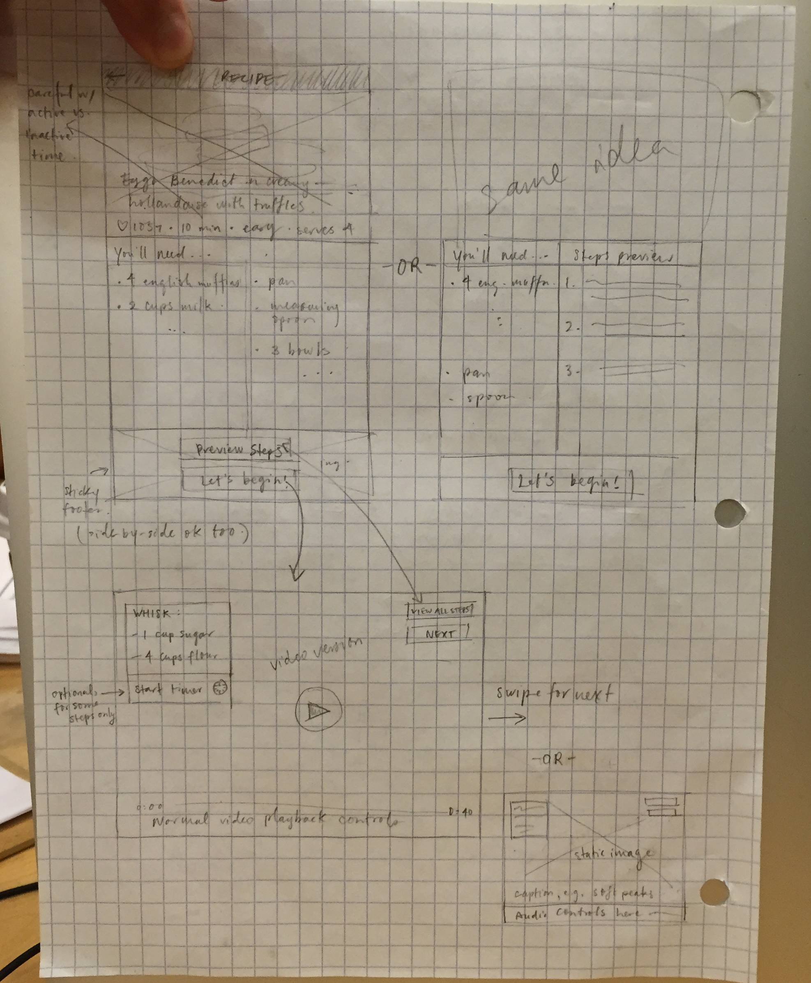
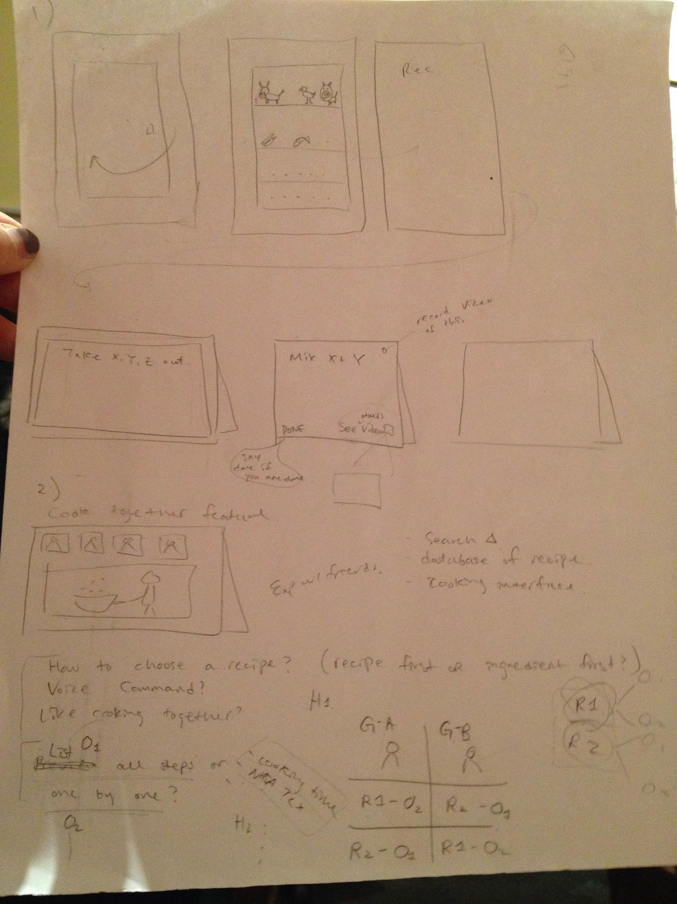
Initial Paper Prototypes

Slide 7
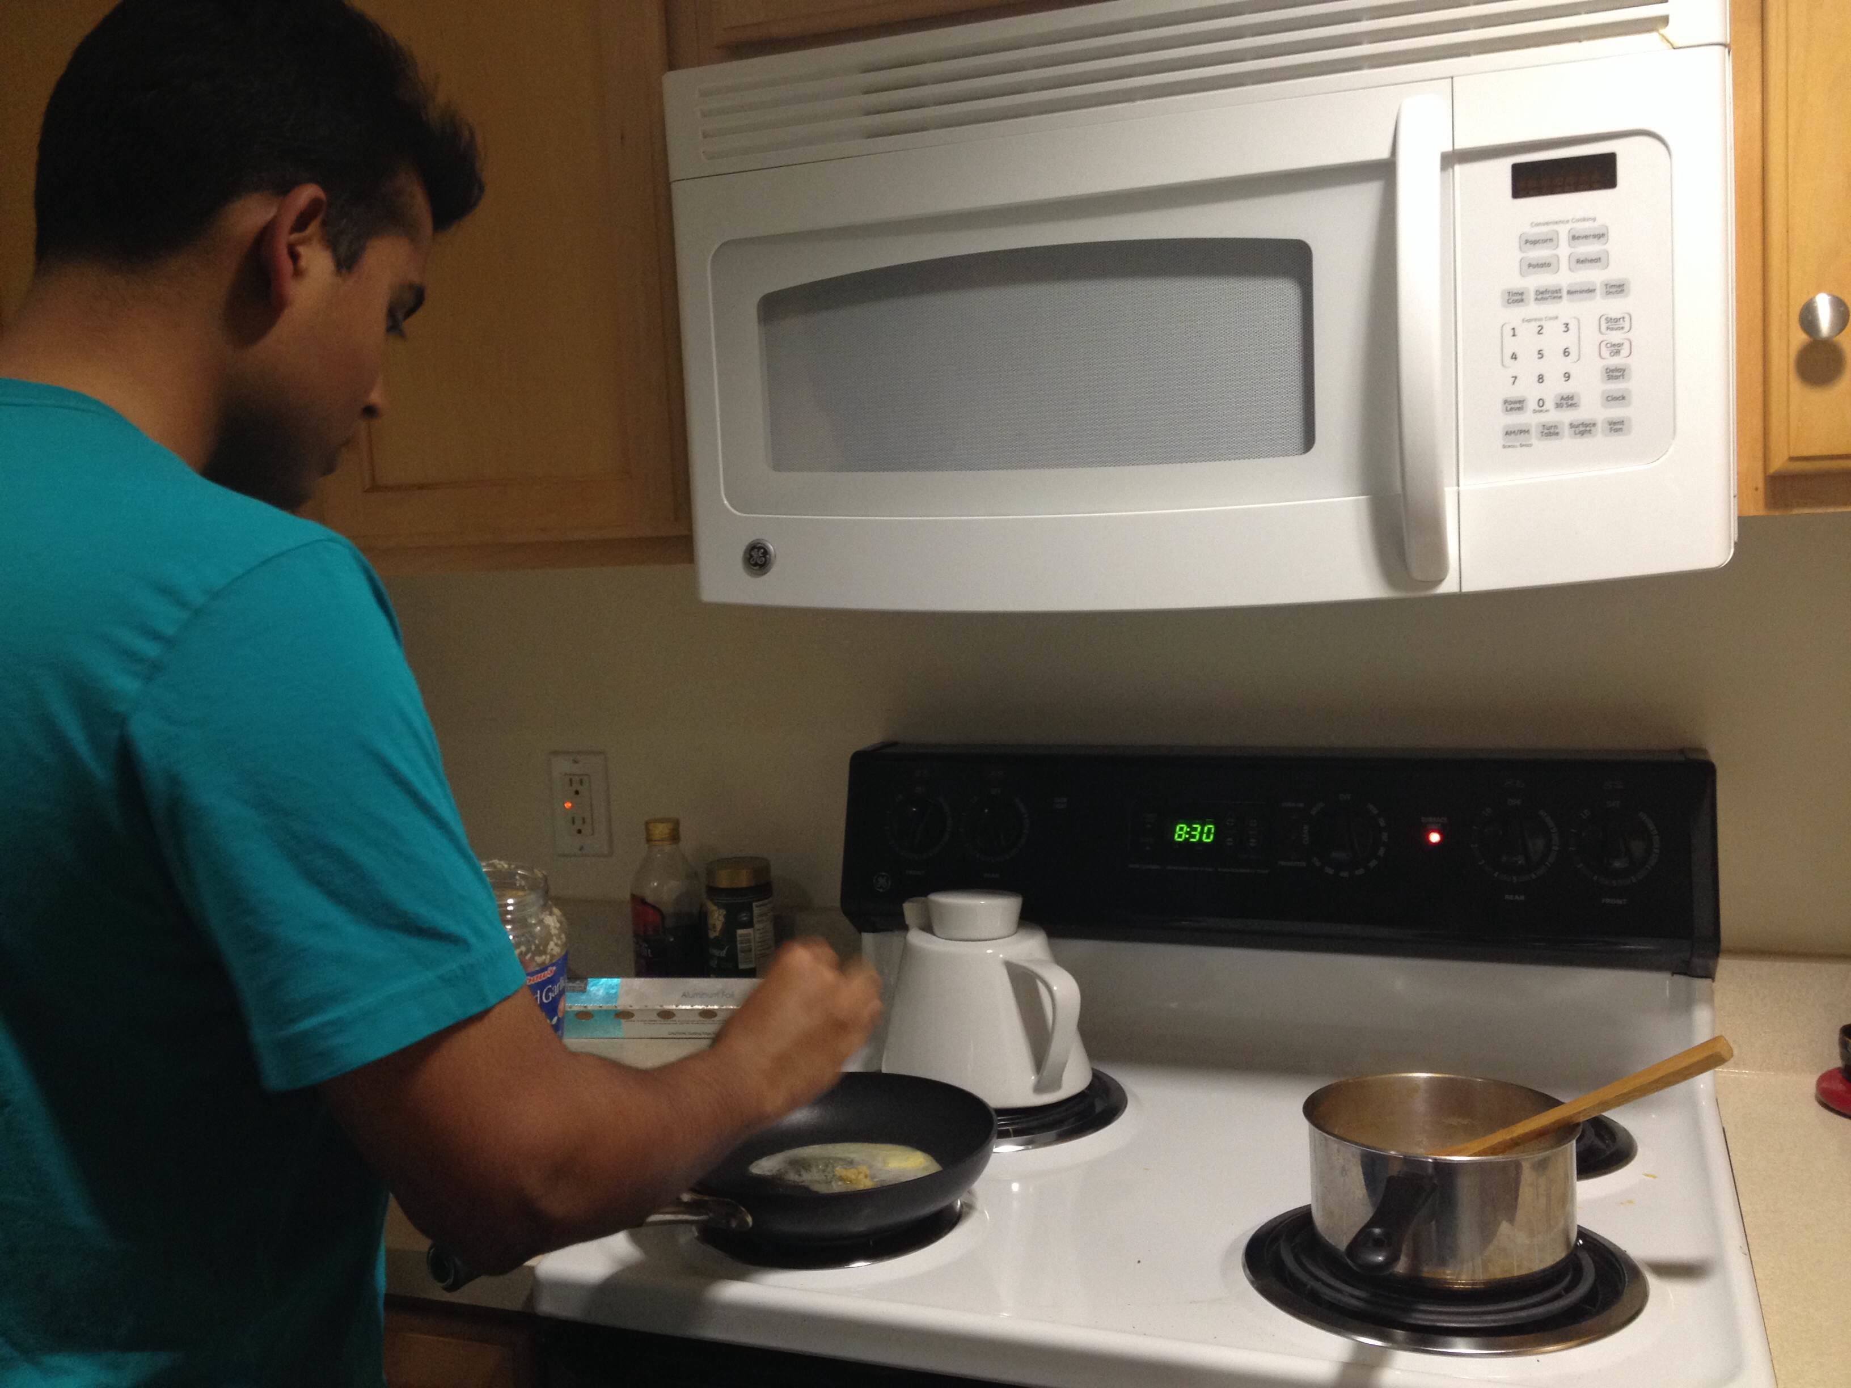
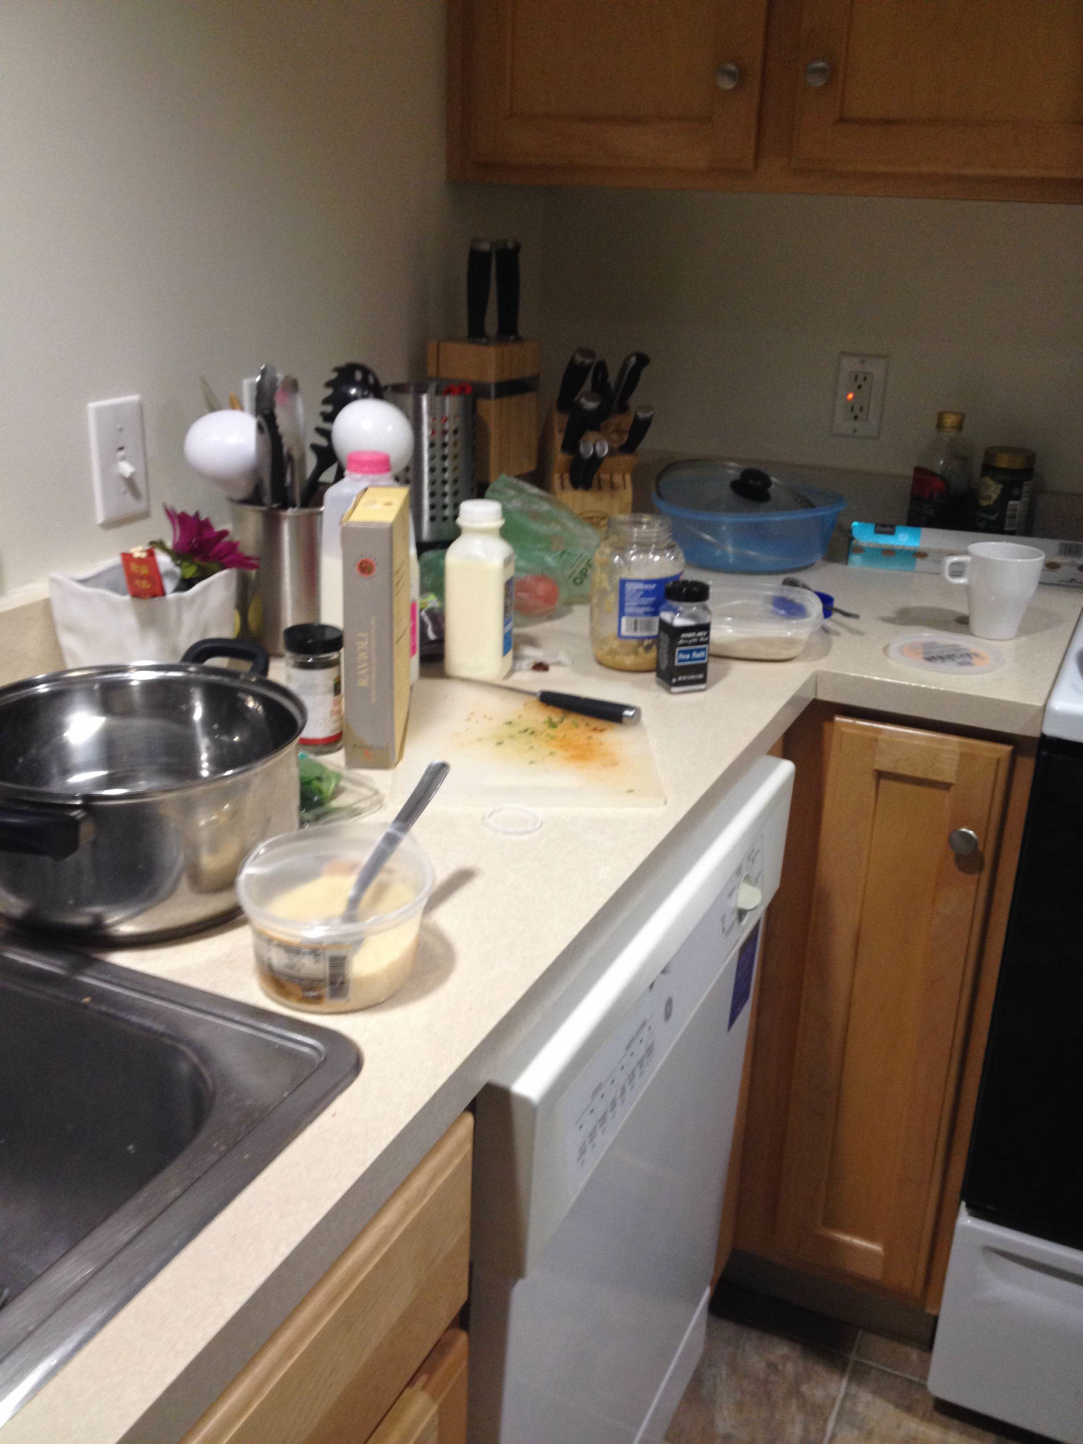
User Study
Observed three subjects
Each subject is asked to cook a dish that he/she has never made before
Asked subjects to narratively describe the process
Took notes on their behaviors and surroundings

Slide 8
User Study: Subject 1
Subject 1 had very little experience in cooking
Primary source of meal is delivery or prepackaged food
Recipe: Ravioli with Creamy Sun-dried Tomato and Basil Sauce
Key observations
Put all ingredients out and measured ingredients accurately in the beginning but roughly estimated using mugs and bowls while cooking
Unsure of cutting shapes
Used resulting images to decide on a shape
Constantly looked at the recipe (> 20 times)
Missed a step
“I have to constantly read over the paragraphs to see what step I am currently on”
Did not look ahead and mistakenly used up all ingredients when some were needed again in later steps
“My assumption is, unless it’s specifically stated to save some for later, put all ingredients in”; “It would have been helpful if recipe is structured in a form that is easier to see what ingredients are coming ahead”
Multitasking: checking pasta boiling while preparing sauce
Brought heated frying pan to other side of kitchen to read recipe
All ingredients (including the ones that were no longer needed) were kept open and outside
Notes:
miriam

Slide 9
User Study: Subject 2
Experienced novice (cooked 3+ days/wk, 4+ years)
Recipe: Goat cheese + mushroom ravioli from scratch
Key observations:
Familiar techniques: Quick glances at key numbers. Prefer improvising based on experience.
Unfamiliar: Prefer illustrations, then complete descriptive explanations. Read recipes for longer periods. Most mistakes made here.
Recipes provide poor explanations of connections between different recipes but that are parts of one dish
Ingredient quantity easily forgotten

Slide 10
User Study: Subject 3
Experienced cook
Had experience roasting spaghetti squash, but had no prior experience preparing this recipe
Recipe: Spaghetti Squash Gratin
Key observations:
Most ingredients were "prepped," meaning a process exists from taking the raw ingredient to the prepped ingredient (e.g. "baked spaghetti squash" as an ingredient).
Subject repeatedly read/scanned entire recipe, often standing idle, contemplating how to go about executing recipe.
Material (pot size) called for by recipe was incorrect (too small).
Timer was only used for items that may burn (warming milk).
When asked, subject stated she preferred recipes that structure preparation process.
Recipe was read ~11 times, but time spent reading recipe ranged from 30 to 90 second periods.
A significant gap was observed between the number of steps carried out by the subject and the number of steps.
Notes:
Details on key observations (for myself during preso):
1) Recipe instructions contained no steps to prepare "prepped" ingredients, nor did estimated prep time account for preparation of these ingredients. (e.g. Baked spaghetti squash, listed as an ingredient, required significant preparation).
2) This suggests subject had to translate the process laid out by the recipe into her own process, implying the process given by the recipe was ineffective ("declarative" vs. "imperative"). This also suggests difficulty in determing which step is being executed, and which ingredients are involved in that step. Also, double checked past steps to ensure no mistakes were made (do what she can to correct at current step).
3) Subject had to improvise (determined that any container would suffice to mix liquid/flour mixture with roasted spaghetti squash).
4) -
5) Suggests a desire to minimize cognitive load of learning a new recipe.
6) This suggests significant cognitive processing involved in learning the recipe.
7) Suggests poor instructional design, which can be improved.

Slide 11
Common Challenges
Repeatedly read/scanned entire recipe
Hard to keep track of current and upcoming recipes
Poor connections between recipes that are parts of one dish
Based on the observations, we want to design an interface that focuses on
Curating a recipe
Connecting recipes that are parts of one dish
Keeping track of ingredients
Show all ingredients, show ingredients used in the current step, and keep track of a rough estimate of ingredient portion
Notes:
Based on how often the ingredient appears in the recipe, we can visually show how much should be used in the current step and how much is expected to be used in later steps.

Slide 12
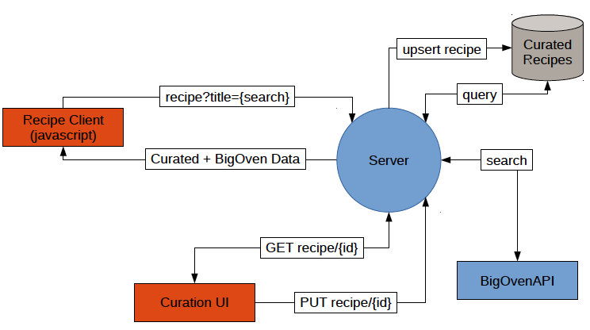
System Design (Ideal Architecture)
Notes:
Discuss structure of BigOven dataset
Preliminary mockup of the interface

Slide 13
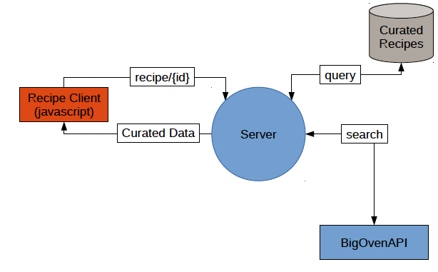
System Design (Target Architecture)
Notes:
Discuss structure of BigOven dataset
Preliminary mockup of the interface

Slide 14
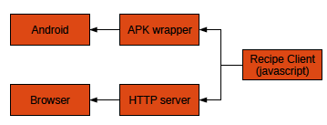
System Design (Target Platforms)
Notes:
Discuss structure of BigOven dataset
Preliminary mockup of the interface

Slide 15
System Design (Interface Design)
Notes:
Discuss structure of BigOven dataset
Preliminary mockup of the interface

Slide 16
Next Steps
Finish building an initial system prototype
Based on the initial system prototype, perform another round of user study
Get feedback from users
Iteratively improve the design

